Slide 1



Addressing Scientific Rigor in Data Analytics using Semantic Workflows
John S. Erickson, John Sheehan, Kristin P. Bennett and Deborah L. McGuinness

Slide 2
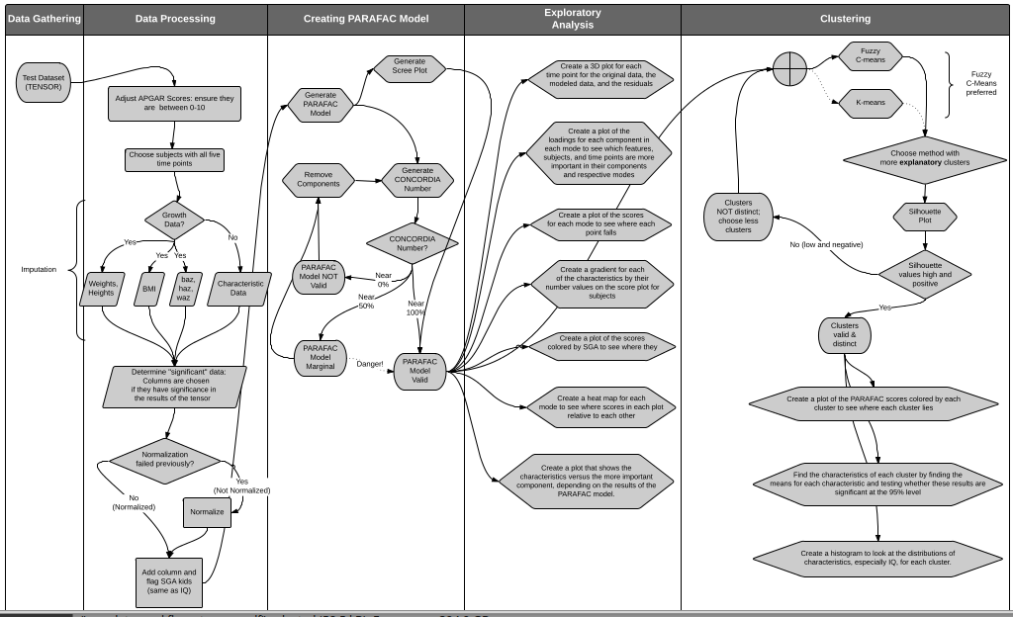
1. My diagram of Hannah's workflow...

Slide 3
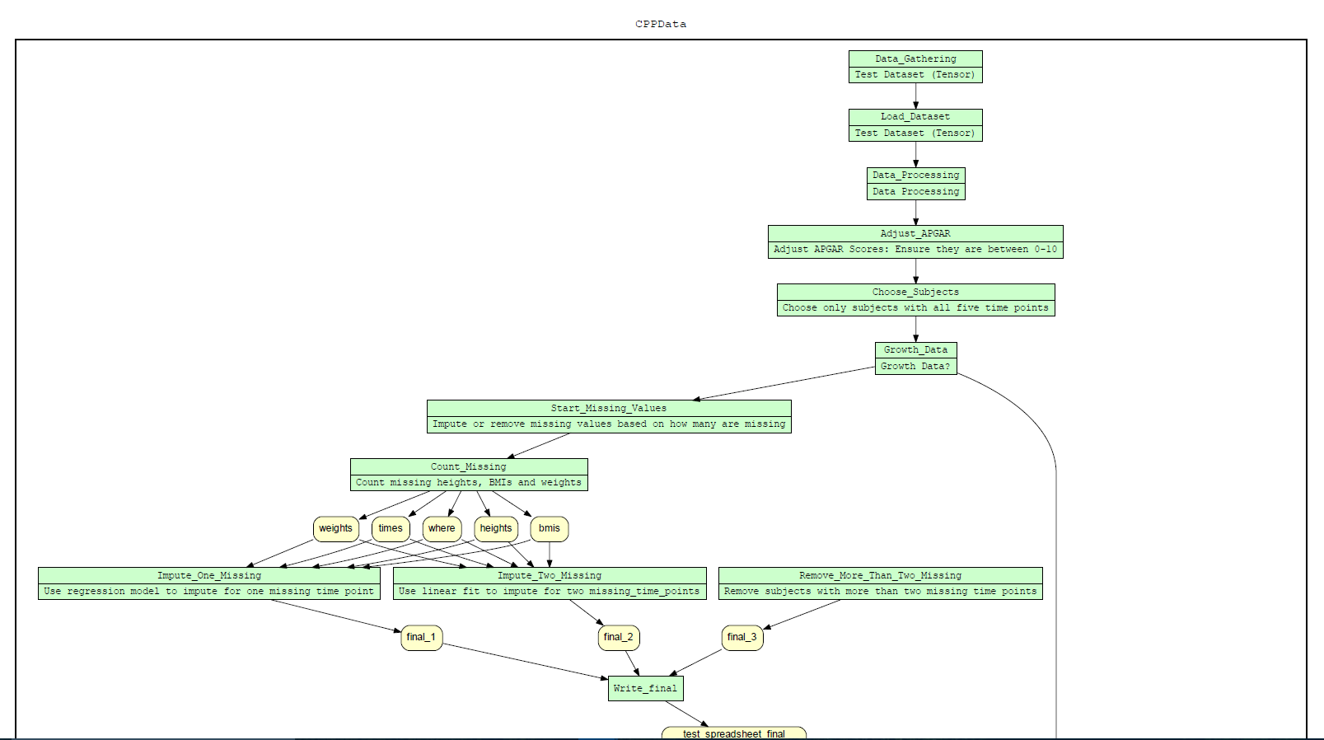
Yes Workflow Representation

Slide 4
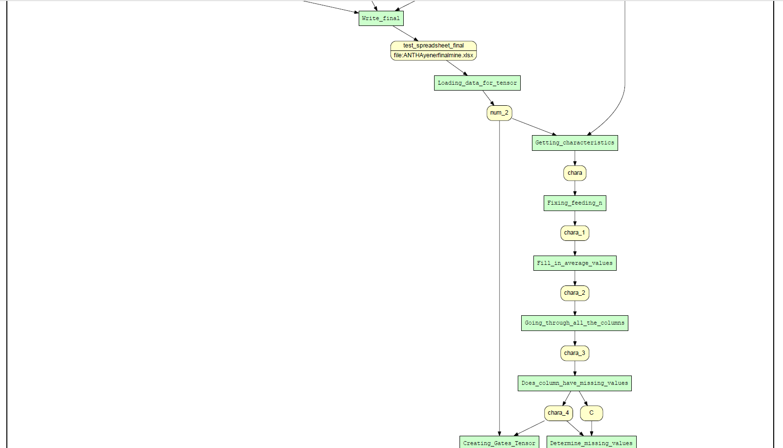
Yes Workflow Representation (Continued)

Slide 5
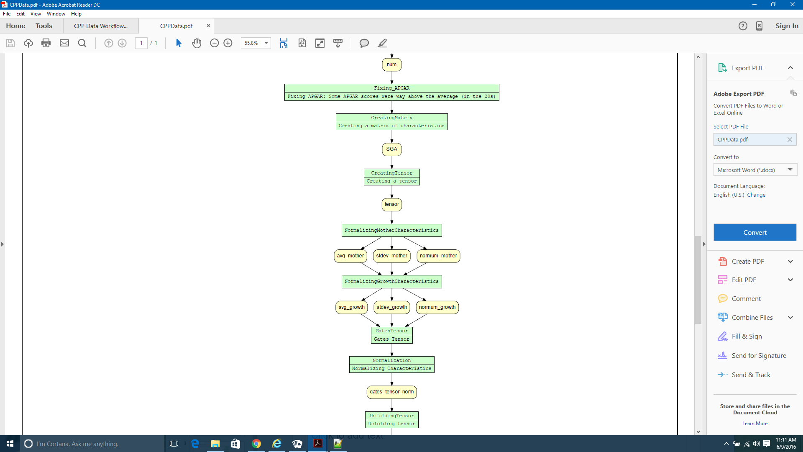
Yes Workflow Representation (Continued)

Slide 6
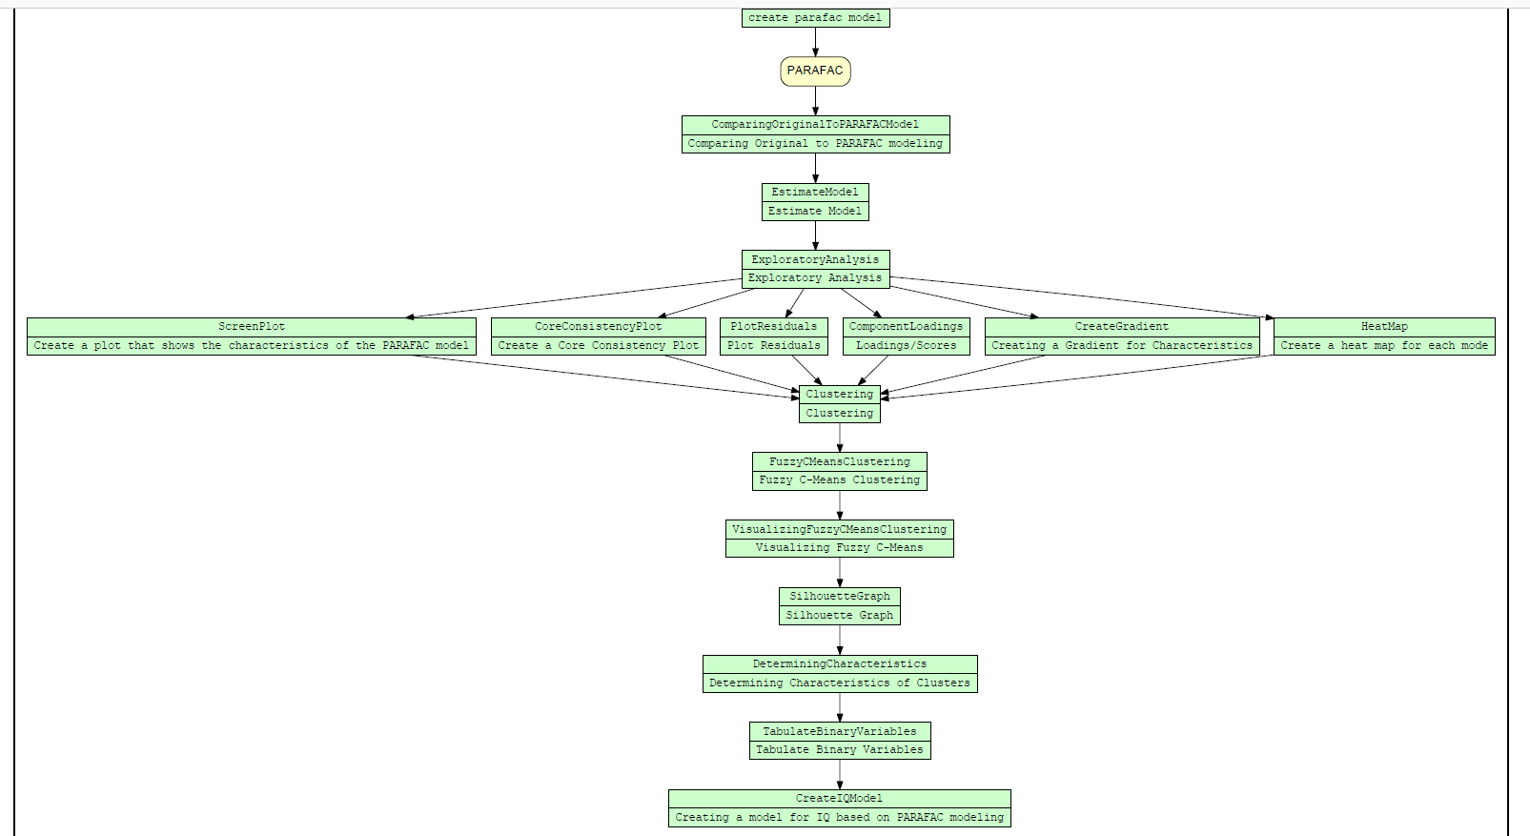
Yes Workflow Representation (Continued)

Slide 7
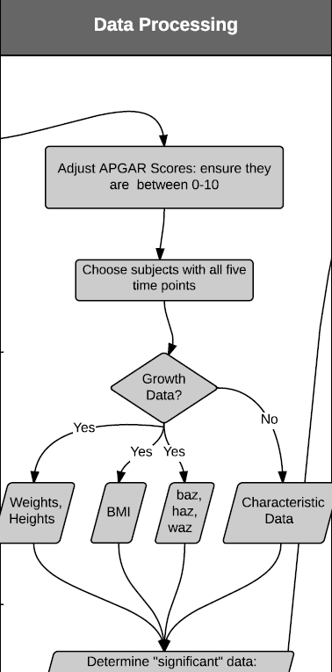
2. ...with specific annotation of how each block and arrow in that workflow should be mapped to ProvONE (it's possible several blocks might be contained in a higher-level Prov block)
:adjust_apgar_scores a provone:Port; dcterms:identifier "test_dataset"^^xsd:string; dcterms:title "Test Dataset (TENSOR)"^^xsd:string; provone:hasInPort :test_dataset; provone:hasOutPort :growth_data; .
:channel_test_dataset_adjust_apgar_scores a provone:Channel; dcterms:identifier "channel_test_dataset_adjust_apgar_scores"^^xsd:string; . :growth_data a provone:Port; dcterms:identifier "growth_data"^^xsd:string; dcterms:title "Growth Data"^^xsd:string; provone:hasInPort :adjust_apgar_scores_dataset; provone:hasOutPort :sga_kids; . .

Slide 8
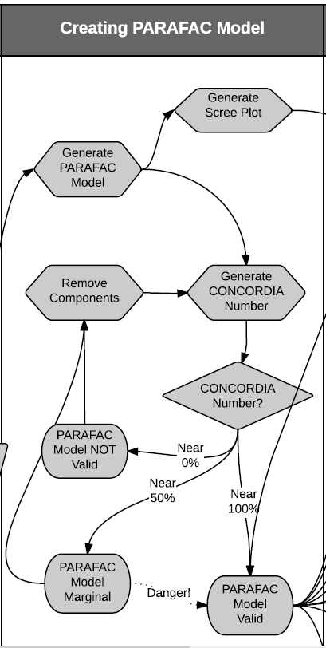
2. ...with specific annotation of how each block and arrow in that workflow should be mapped to ProvONE (it's possible several blocks might be contained in a higher-level Prov block)
:generate_parafac_model a provone:Port; dcterms:identifier "generate_parafac_model"^^xsd:string; dcterms:title "Generate PARAFAC Model"^^xsd:string; provone:hasInPort :sga_kids; provone:hasOutPort :generate_plots; . :channel_generate_parafac_model_generate_plots a provone:Channel; dcterms:identifier "generate_parafac_model_generate_plots"^^xsd:string; . . .

Slide 9
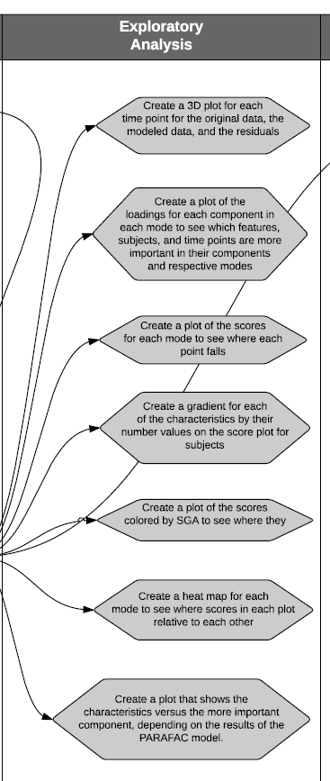
2. ...with specific annotation of how each block and arrow in that workflow should be mapped to ProvONE (it's possible several blocks might be contained in a higher-level Prov block)
:generate_plots a provone:Port; dcterms:identifier "generate_plots"^^xsd:string; dcterms:title "Generate Plots"^^xsd:string; provone:hasInPort
.
:generate_parafac_model; provone:hasOutPort :fuzzy_c_means_clustering; .
:channel_generate_parafac_model_generate_plots a provone:Channel; dcterms:identifier "generate_parafac_model_generate_plots"^^xsd:string; .

Slide 10
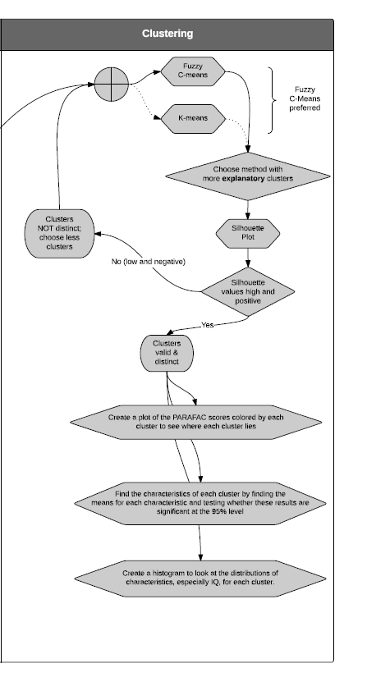
2. ...with specific annotation of how each block and arrow in that workflow should be mapped to ProvONE (it's possible several blocks might be contained in a higher-level Prov block)
:channel_generate_plots_fuzzy_c_means_clustering a provone:Channel; dcterms:identifier "generate_plots_fuzzy_c_means_clustering"^^xsd:string; . :fuzzy_c_means_clustering a provone:Port; dcterms:identifier "fuzzy_c_means_clustering"^^xsd:string; dcterms:title "Fuzzy C Means Clustering"^^xsd:string; provone:hasInPort :generate_plots; provone:hasOutPort :create_iq_histogram; . :channel_fuzzy_c_means_clustering_generate_plots a provone:Channel; dcterms:identifier "fuzzy_c_means_clustering_generate_plots"^^xsd:string; . :create_iq_histogramg a provone:Port; dcterms:identifier "create_iq_histogram"^^xsd:string; dcterms:title "Create IQ Histogram"^^xsd:string; provone:hasInPort :fuzzy_c_means_clustering; . . : .

Slide 11
3. Where ProvONE mapping isn't possible, suggest an alternative or extension
In a case like this,
Not sure how to model
Growth Data? Decision
using ProvONE or YW?

Slide 12
4. For each block (and possibly arrow), suggest a conceptual mapping to one or more domain ontologies. Doesn't have to be STAT-O.
:channel_generate_plots_fuzzy_c_means_clustering a provone:Channel; dcterms:identifier "generate_plots_fuzzy_c_means_clustering"^^xsd:string; . :fuzzy_c_means_clustering a provone:Port; dcterms:identifier "fuzzy_c_means_clustering"^^xsd:string; dcterms:title "Fuzzy C Means Clustering"^^xsd:string; provone:hasInPort :generate_plots; provone:hasOutPort :create_iq_histogram; . :channel_fuzzy_c_means_clustering_generate_plots a provone:Channel; dcterms:identifier "fuzzy_c_means_clustering_generate_plots"^^xsd:string; . :create_iq_histogramg a provone:Port; dcterms:identifier "create_iq_histogram"^^xsd:string; dcterms:title "Create IQ Histogram"^^xsd:string; provone:hasInPort :fuzzy_c_means_clustering; . . : .
STAT-O

Slide 13
5. Where an ontology mapping for the concept/intention of a code block is not possible, suggest a class in a new ontology; "sw" (semantic workflow) or something.
Gates Tensor?
%% @begin Creating_Gates_Tensor %% @in num @as num_2 %% @in chara @as chara_4 %% @out gates_tensor gates_tensor = NaN(21382,23,5); t = 1; % time counter for k = [1 123 366 1462 2558] logical = (num(:,3) == k); gates_tensor(:,:,t) = [chara(:,1) num(logical,4:10) chara(:,2:end)]; t = t + 1; % increment time counter end %% @end Creating_Gates_Tensor
:tensor_gates a sw:Tensor; dcterms:identifier "gates_tensor"^^xsd:string;

Slide 14
6. Prototype the RDF that represents a complete workflow knowledge graph of the above
@prefix rdfs: <http://www.w3.org/2000/01/rdf-schema#> .
@prefix xsd: <http://www.w3.org/2001/XMLSchema#> .
@prefix owl: <http://www.w3.org/2002/07/owl#> .
@prefix dcterms: <http://purl.org/dc/terms/> .
@prefix prov: <http://www.w3.org/ns/prov#> .
@prefix provone: <http://purl.org/provone> .
@prefix wfms: <http://www.wfms.org/registry.xsd> .
@prefix rdf: <http://www.w3.org/1999/02/22-rdf-syntax-ns#> .
@prefix provone: <http://dataone.org/ns/provone#> .
@prefix yw: <http://yesworkflow.org/ns/yesworkflow#> .
:program_cpp
a provone:Program;
dcterms:identifier "CPP_Data"^^xsd:string;
dcterms:title "CPP_Data"^^xsd:string;
.
:process_cpp
a provone:Process;
dcterms:identifier "CPP_Data"^^xsd:string;
dcterms:title "CPP_Data"^^xsd:string;
.
:workflow_cpp
a provone:Workflow;
dcterms:identifier "CPP_Workflow"^^xsd:string;
dcterms:title "CPP_Workflow"^^xsd:string;
.
:test_dataset
a provone:Port;
dcterms:identifier "test_dataset"^^xsd:string;
dcterms:title "Test Dataset (TENSOR)"^^xsd:string;
provone:hasOutPort :adjust_apgar_scores;
.

Slide 15
6. Prototype the RDF that represents a complete workflow knowledge graph of the above
:adjust_apgar_scores a provone:Port; dcterms:identifier "test_dataset"^^xsd:string; dcterms:title "Test Dataset (TENSOR)"^^xsd:string; provone:hasInPort :test_dataset; provone:hasOutPort :growth_data; . :channel_test_dataset_adjust_apgar_scores a provone:Channel; dcterms:identifier "channel_test_dataset_adjust_apgar_scores"^^xsd:string; . :growth_data a provone:Port; dcterms:identifier "growth_data"^^xsd:string; dcterms:title "Growth Data"^^xsd:string; provone:hasInPort :adjust_apgar_scores_dataset; provone:hasOutPort :sga_kids; . :channel_adjust_apgar_scores_sga_kids a provone:Channel; dcterms:identifier "adjust_apgar_scores_sga_kids"^^xsd:string; . :sga_kids a provone:Port; dcterms:identifier "sga_kids"^^xsd:string; dcterms:title "SGA Kids"^^xsd:string; provone:hasInPort :adjust_apgar_scores_dataset; provone:hasOutPort :generate_parafac_model; . :channel_sga_kids_generate_parafac_model a provone:Channel; dcterms:identifier "sga_kids_generate_parafac_model"^^xsd:string; . :

Slide 16
6. Prototype the RDF that represents a complete workflow knowledge graph of the above
:channel_generate_parafac_model_generate_plots a provone:Channel; dcterms:identifier "generate_parafac_model_generate_plots"^^xsd:string; . :generate_plots a provone:Port; dcterms:identifier "generate_plots"^^xsd:string; dcterms:title "Generate Plots"^^xsd:string; provone:hasInPort :generate_parafac_model; provone:hasOutPort :fuzzy_c_means_clustering; . :channel_generate_plots_fuzzy_c_means_clustering a provone:Channel; dcterms:identifier "generate_plots_fuzzy_c_means_clustering"^^xsd:string; . :fuzzy_c_means_clustering a provone:Port; dcterms:identifier "fuzzy_c_means_clustering"^^xsd:string; dcterms:title "Fuzzy C Means Clustering"^^xsd:string; provone:hasInPort :generate_plots; provone:hasOutPort :create_iq_histogram; . :channel_fuzzy_c_means_clustering_generate_plots a provone:Channel; dcterms:identifier "fuzzy_c_means_clustering_generate_plots"^^xsd:string; . :create_iq_histogramg a provone:Port; dcterms:identifier "create_iq_histogram"^^xsd:string; dcterms:title "Create IQ Histogram"^^xsd:string; provone:hasInPort :fuzzy_c_means_clustering; . :

Slide 17
7. Itemize a set of suggested YW extensions or modifications (e.g. parameterization of existing tags) that could achieve the above. This should include coding examples and desired outcome.
%% @begin Growth_Data
%% @desc Growth Data?
%% @out Start_Missing_Values
%% @out Getting_characteristics
%% @end Growth_Data
%% @begin Start_Missing_Values
%% @desc Impute or remove missing values based on how many are missing
%% @out Count_Missing
for p = 1:size(subj,1) % interate through the total number of subjects
k = subj(p); % what subject number?
ib = find(ismember(final(:,2),k)); % dealing with one subject
%% @end Growth_Data
%% @begin Count_Missing
%% @desc Count missing heights, BMIs and weights
%% @out heights
%% @out bmis
%% @out weights
%% @out times
%% @out where
heights = final(ib,5); % heights for that subject
bmis = final(ib,6); % bmis for that subject
weights = final(ib,4); % weights for that subject
times = final(ib,3); %times for that subject
where = isnan(final(ib,5)); % which values are missing?
count = sum(where); % how many are missing?
%% @end Count_Missing
In a case like this,
Not sure how to model
Growth Data? Decision
using ProvONE or YW?

